Slide 1
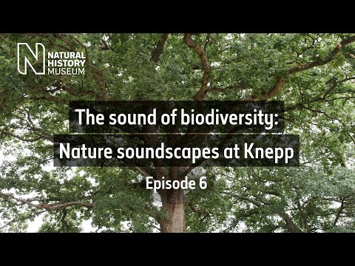
Nature Mindfulness
Notes:
https://www.youtube.com/watch?v=ayg-4jJtZf4
As pupils are arriving into the assembly/for the first minute of the assembly- play the video.
Encourage pupils to take time to be mindful and listen to what they can hear.
End the video with a quick plenary asking pupils what they could hear and how the sounds make them feel.
You could ask pupils to raise their hands and talk about what they heard and how they felt or you could ask the pupils to raise their hands if they heard birds, trees moving etc. And raise their hand if they felt calm, happy, relaxed etc.
Transition into the intro to the assembly by talking about how nature has an important role to play in helping our wellbeing and can help us switch off and relax from the everyday business of life. Therefore protecting nature and increasing nature on our education setting site is really important, not just for biodiversity but also for our own wellbeing.

Slide 2
Nature Restoration: Your part in supporting local nature to thrive
The National Education Nature Park
Notes:
Nature in England has declined over time, with many plants and animals that live in our country being lost. As a school, we are joining a new programme that other schools across England are taking part in to help restore nature. In today's assembly we are going to talk about what we are going to do and how you all can play a role in supporting local nature to thrive. When we work together we can have a massive positive impact and that's what the National Education Nature Park is all about, bringing together places of education across the country, to take action to contribute to nature recovery in England.

Slide 3

Nature Mysteries
Notes:
OPTION A take photos from your school grounds of-
A plant growing in an unexpected place
A shadow made from something natural like a tree
A living thing students would know the name of, very zoomed in/blurred out so they can't see much of it! Ideally a plant.

Slide 4


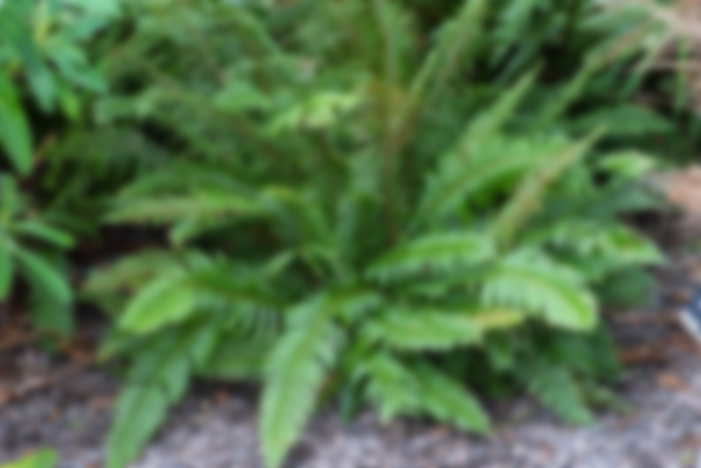
Nature Mysteries
Notes:
OPTION B-
A plant growing in an unexpected place
A shadow of a tree
A fern

Slide 5
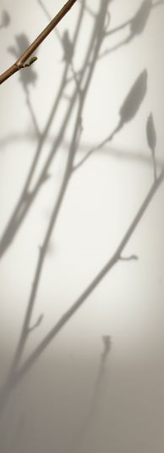
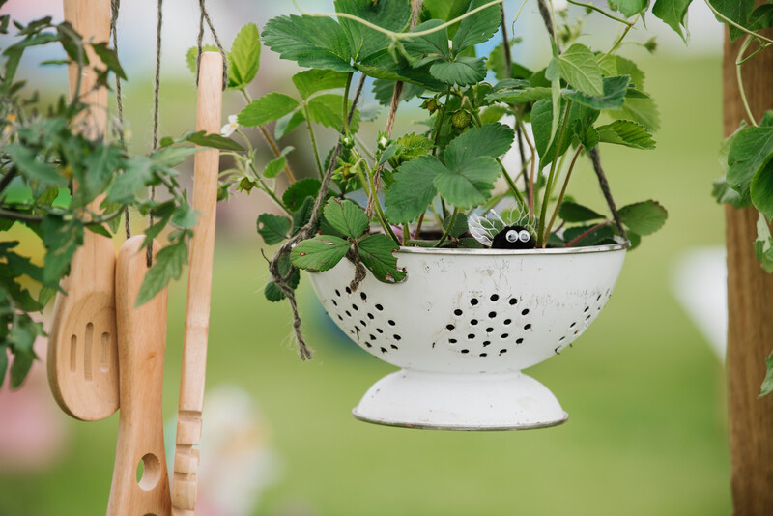
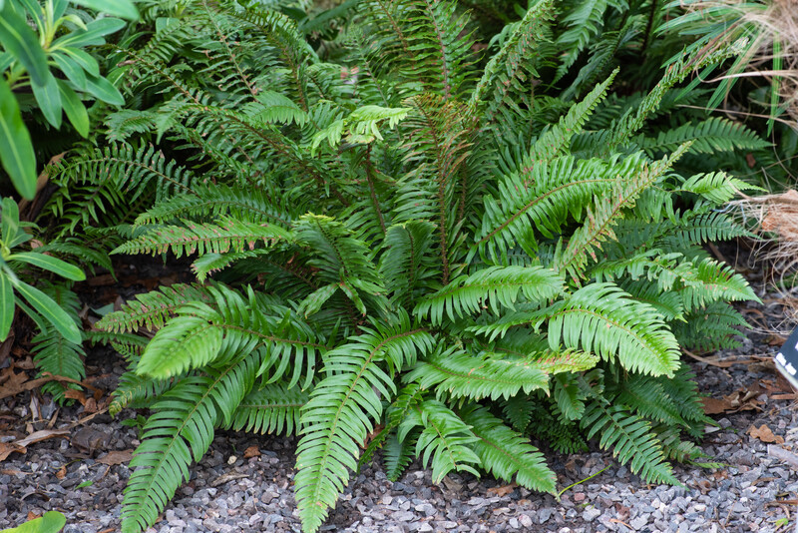
Nature Mysteries
Notes:
OPTION B-
A plant growing in an unexpected place. Even the smallest plant makes a positive difference and we can recycle lots of things to use as plant pots. Plants can be found in the most unexpected places.
A shadow of a tree. Trees are an incredibly important part of nature. Did you know that a mature Oak tree consumes the equivalent of 6048 cups of water per day! Trees can therefore play a crucial role in protecting against flooding. Trees also communicate through an underground fungal internet, referred to as the ‘wood wide web’. Trees and plants communicate with each other using a massive network of underground fungi. If a tree is being attacked by insects, it can use the wood wide web to warn other trees to trigger their own defences.
A fern. Plants are living things too as well as wildlife and they play an important role in ecosystems. Ferns are really cool! They are some of the oldest plants on the Earth and have been around for millions of years, before dinosaurs even existed. There are over 10,000 different types of ferns and some can live for up to 100 years.

Slide 6



Who has developed the National Education Nature Park?

Slide 7
Who has developed the National Education Nature Park?
Notes:
The National Education Nature Park has been developed by a partnership led by the Natural History Museum with the Royal Horticultural Society (RHS) and the Royal Society. Other organisations are supporting the project including the Royal Geographical Society, Manchester Metropolitan University, Learning Through Landscapes, UK Centre for Ecology and Hydrology and the National Biodiversity Network Trust.
The Natural History Museum is based in London and is famous for its dinosaurs. As well as being a world-class visitor attraction, the NHM is a leading science research centre, using their expertise to tackle the biggest challenges facing the world today.
The RHS is the UK's leading gardening charity, working to get everyone involved in gardening. They run the Campaign for School Gardening which 50% of schools in the UK are members of.
The Royal Society is a group of the world's most influential scientists who encourage the development and use of science for the benefit of humanity.

Slide 8
Nature issues in our local area
Notes:
Insert relevant local nature issues.
Examples could include:
Trees being removed outside your school grounds
Air pollution
Lack of green space
Flooding

Slide 9
The UK is one of the most nature-depleted countries in the world
Declined by 95% since 1950 ​
Levels of biodiversity monitoring have been scaled back ​​
41% of UK species have declined since the 1970s ​​
Young people are spending less time outdoors ​
Notes:
The UK is one of the most nature-depleted countries in the world
41% of UK species have declined since the 1970s
Hedgehog numbers have declined by 95% since 1950
Levels of biodiversity monitoring have been scaled back
Young people are spending less time outdoors

Slide 10
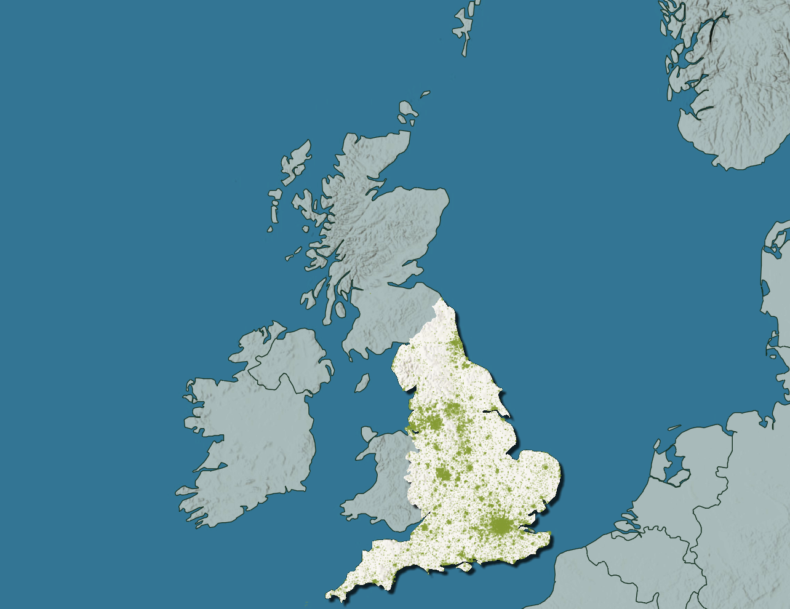
The National Education Nature Park
Notes:
To do our bit to help nature restoration in England, we are joining the National Education Nature Park, a network of education settings across the country who are taking action to improve nature on their site.
The planetary emergency requires understanding and action from all, so whether you are an aspiring scientist or writer, campaigner or artist, the programme will develop your specific skills which you can carry forward into your future careers.
Taking part in the National Education Nature Park will also help us develop a connection to nature and provide us with the agency to do something about nature depletion in England. Research has shown that spending time outdoors has overwhelmingly positive impacts on our physical, mental and emotional wellbeing, so we hope that taking part can provide those benefits for our school community too.
Our grounds are our nature park. Each school will be working to make their nature park better for people and nature and together all of the small changes we make will add up to make a large collective positive difference for nature recovery in England. No one is too small to make a difference and every action we take is helping nature to thrive in our local area. The land from every nursery, school and college in England forms an area that is more than twice the size of Birmingham, so we have a massive opportunity to create widescale positive change.

Slide 11

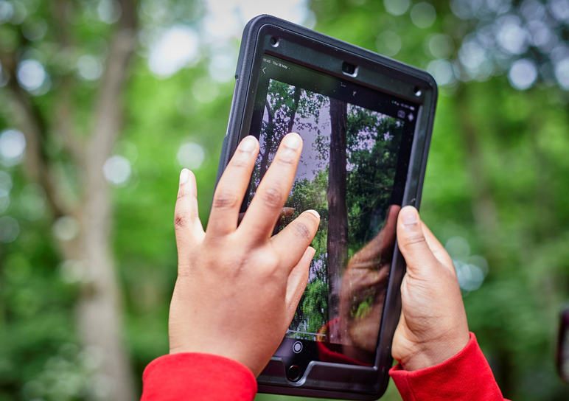
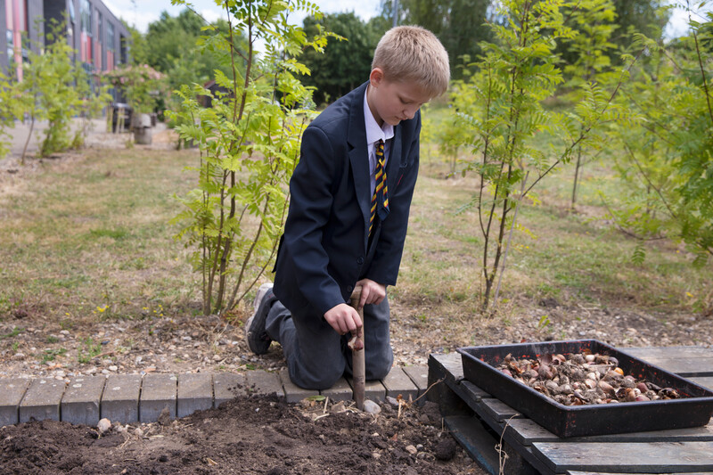
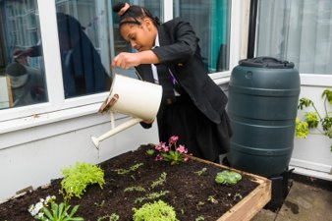
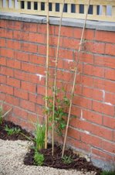
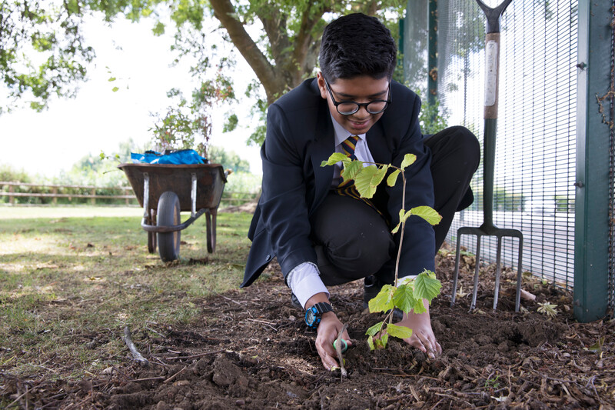
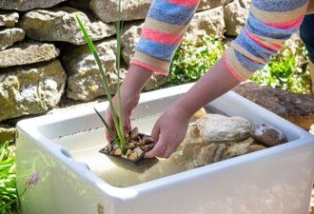
Our Nature Park
Notes:
So how will it work?
Our Nature Park will create the most positive impact if everyone at (insert education setting) gets involved.
We will start by getting to know our site by mapping habitats, surveying what is living and growing there and understanding how it is used by us.
Using creative thinking and collaboration skills, together with the latest scientific evidence provided by the programme, we will then put together a plan to improve their site for nature.
We might create ponds, plant flowers, grow fruit and vegetables, plant trees, create a green wall or capture rainwater in water butts (delete anything you have already done. ‘We have already____ and we will continue to make a positive difference by….’). What we choose to do will be specific to the context of our school site.
After changes have been made, we will continue to monitor what is living and growing on their site. We will be able to see the difference we have made for nature on our own learning site and also be able to see the collective difference the National Education Nature Park is making for nature across the country on an online map.
The Nature Park will use exciting new digital technology called Geographic Information System (GIS), which some of you may have heard of. GIS is increasingly used in a wide range of careers including app developers, conservationists, engineers, surveyors, urban planners and is a skill that is in high-demand in the UK, so this is an excellent opportunity for you to develop these skills.

Slide 12

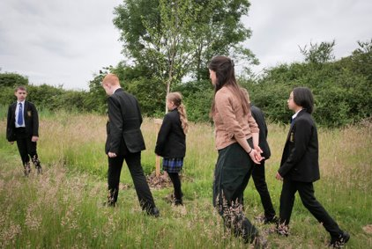
Your contribution to Nature restoration
We can develop green and digital skills to use in future careers
We can improve our physical, mental and emotional wellbeing
We can contribute to nature recovery in England
We can take part in real scientific research
We can enhance biodiversity in our local area
We can gain recognition with the Climate Action Awards
Notes:
Taking part in the Nature Park has so many benefits, for biodiversity and people.
The Nature Park will allow us to:
Develop green and digital skills to use in future careers. GIS is a highly valued skill.
Improve our physical, mental and emotional wellbeing- access to green space and outdoor learning has been shown to have overwhelmingly positive impacts on the physical, mental, and emotional wellbeing of young people. The Nature Park will also help to build agency to respond positively and tangibly to biodiversity and climate crises.
Contribute to nature recovery in England- every small improvement we make on our school site will add up, when combined with other schools in England taking action on their sites.
Take part in real life scientific research- school grounds are the most under-recorded urban habitat type in England. We will be contributing to a deeper understanding of biodiversity in England.
Enhance biodiversity in our local area- we will lead the way for our local community.
Gain recognition with the Climate Action Awards- we will be able to apply for Climate Action Awards, which will recognise schools who are championing nature and working towards a sustainable future.

Slide 13
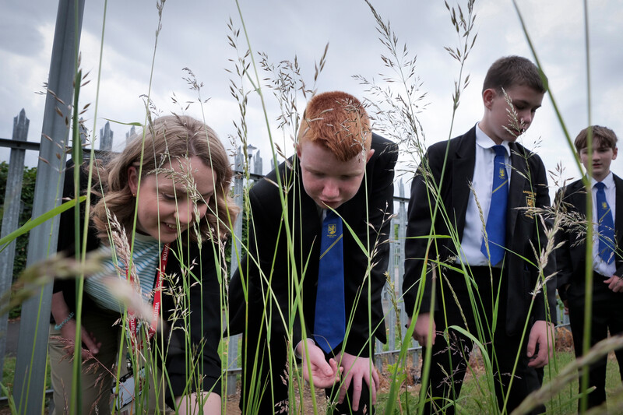
How can staff members help?
Teachers can use the Nature Park resources to support curriculum delivery
Head teachers can support teachers and help us to grow and develop our outdoor spaces
Geography leads can take part in fieldwork studies using GIS technology
Science leads can take part in real life scientific research on biodiversity
Wellbeing leads can help pupils build agency to respond positively to the biodiversity crisis
Careers leads can help pupils develop skills for their future
Notes:
Our Nature Park journey will involve pupils AND school staff! We will all come together to make the biggest difference for nature. Everyone has a part to play, and you don’t need any previous experience teaching about nature or climate change.
Staff, we need you too! On the screen there are some suggestions about how you could get involved and use your expertise to help our nature park journey. The programme is flexible and can be used by all members of school staff in different ways.
Teachers can use the Nature Park resources to support curriculum delivery
Head teachers can support teachers and help us to grow and develop our outdoor spaces
Geography leads can take part in fieldwork studies using GIS technology
Science leads can take part in real life scientific research on biodiversity
Wellbeing leads can help pupils build agency to respond positively to the biodiversity crisis
Careers leads can help pupils develop skills for their future

Slide 14
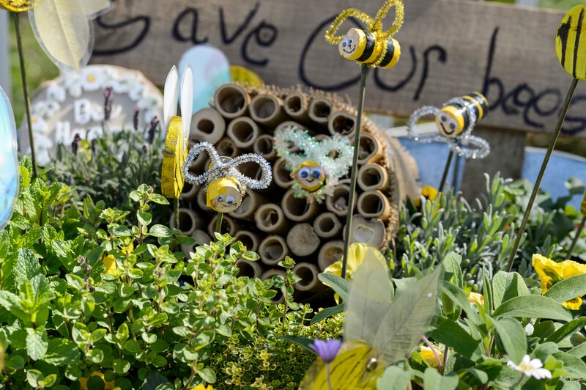







What impact could we have?
Every school and pupil in England we could create:
24,413
9.1 million
Notes:
If every school in England, that’s 24,413 schools, did one small thing such as install plants for pollinators.
We would create thousands of safe homes for insects and animals. Homes for bugs, bees, butterflies, birds, spiders, worms, frogs and more.
If every student in England, that’s 9.1 million young people, did one small thing such as plant a fruit tree.
We would create millions of homes for wildlife, provide food for pollinators and people and help clean the air that we breathe.

Slide 15
Let's get started!
Notes:
On this slide, you can insert any specific information about how pupils and staff at your school can get involved. If you are a lead teacher, you could put your contact details down for other staff to contact you to get involved. You could insert information about how pupils could help. This slide could also include information about what the first thing you will be doing or what different year groups will be doing. If you are not sure yet this slide can just be a closing thank you slide :)
You could also suggest tiny calls-to-action that pupils (and staff!) could do. For example: spend time outside at break/lunch and do some nature mindfulness and take some time to listen to what you can hear, walk around the grounds and think about what you like and don't like, brainstorm some ideas for how we could improve our site for nature, talk to a teacher and encourage them to sign up, email other staff with this template: (insert email template), use the Nature Park taster activity with your class: https://storymaps.arcgis.com/stories/8557212491554e0fb518705925f1a37e

Slide 16
Thank you (insert education setting name)

